Slide 1


GLOBAL
CONSULTING
Enterprise Risk
Management
Building resilient, data-driven risk capabilities to protect value and drive strategic growth.
PREPARED FOR
DATE
REFERENCE
Board Risk Committee
December 2025
ERM-2025-Q4

Slide 2



01
Executive Summary
Key objectives, highlights, and decisions
02
ERM Overview & Framework
Table of
Purpose, COSO alignment, and scope
Contents
03
Governance & Appetite
Roles, committees, and thresholds
04
Assessment Methodology
Likelihood, impact, and scoring
05
Risk Matrix & Heat Map
This document outlines the strategic framework, governance models, and data-driven dashboards for enterprise risk management.
Visualizing risk distribution
06
Top Risks & Register
Critical enterprise risks ranking
07
Dashboards & KPIs
Monitoring performance and breaches
08
Risk Deep Dives
Detailed analysis by category
09
Mitigation & Reporting
Action plans and communication
10
Roadmap & Next Steps
Implementation and recommendations
11
About & Contact
Team credentials and inquiries

Slide 3







Executive Summary
ENTERPRISE RISK MANAGEMENT
Strategic Objectives
Risk Profile Snapshot
Align Strategy: Ensure risk appetite frameworks actively support the 2026 aggressive growth targets in emerging markets.
4
2
85%
TOTAL RISKS
CRITICAL
CONTROL EFF.
Protect Value: Minimize exposure to operational disruptions and fortify cyber resilience against evolving threats.
RESIDUAL RISK DISTRIBUTION
Compliance Assurance: Proactively address new global regulatory standards (e.g., AI Act, ESG disclosures) to avoid penalties.
4
1
Top 3 Enterprise Risks
RESIDUAL RISK STATUS
2
3
1
Cyber Security & Data Privacy
CRITICAL
Increasing sophistication of ransomware; 3rd party vulnerabilities.
Trending Up
Decisions Required
Supply Chain Resilience
NORMAL
2
HIGH
Geopolitical instability affecting key component availability.
Stable
1
Approve revised Risk Appetite Thresholds for Q1 2026.
2
Sanction budget for the Cyber Defense Acceleration program ($1.5M).
Regulatory Change
CRITICAL
3
HIGH
Complexity in cross-border data transfer compliance.
3
Sign-off on the quarterly Top 10 Risk Register submission.
Trending Up
CONFIDENTIAL & PROPRIETARY
Page 03

Slide 4









Risk Governance Structure
ORGANIZATION & ROLES
The governance model ensures appropriate oversight, accountability, and communication across the enterprise. It is structured around the Three Lines of Defence model to separate risk ownership, risk monitoring, and independent assurance.
Board of Directors
OVERSIGHT
Risk Committee & Audit Committee
STRATEGY & EXECUTION
Executive Management
CEO, CRO, ExCo
1st Line
2nd Line
3rd Line
RISK OWNERSHIP
RISK OVERSIGHT
INDEPENDENT ASSURANCE
Business Units & Operations
Risk Mgmt & Compliance
Internal Audit
Identify and assess risks in day-to-day operations.
Establish risk frameworks and policies.
Provide independent assurance on control effectiveness.
Challenge 1st line assessments and monitor exposure.
Enterprise Risk Management (ERM) Toolkit
Full suite available: https://synergieconsultation.podia.com/suite-entreprise-risk-management-erm
WHAT'S INCLUDED
This comprehensive four-file bundle contains everything required for a professional enterprise risk management deployment:
-37 Professional PowerPoint Slides
-Excel Companion Workbook (6 Worksheets)
-12-Month Implementation Project Plan (Excel)
-Implementation Checklist and Best Practices Guide (Word) – 20-page playbook
Implement and maintain internal controls.
Review governance and risk management processes.
Execute remediation plans.
Report on aggregate risk profile.
KEY ROLES
KEY ROLES
KEY ROLES
Process Owners
Dept Heads
ERM Team
Compliance
CISO
Internal Audit
External Audit
CONFIDENTIAL & PROPRIETARY
Page 06

Slide 5







About Us & Contact
LET'S CONNECT
Your Partner in Enterprise Resilience
WHO WE ARE
OUR EXPERTISE
ERM Framework Design & Implementation
We are a premier global risk consulting firm dedicated to helping organizations navigate uncertainty. With a data-driven approach, we bridge the gap between strategic ambition and operational resilience. Our experts integrate deep industry knowledge with cutting-edge analytics to transform risk into a competitive advantage.
Risk Appetite & Tolerance Setting
Custom Risk Dashboard Development
15+
500+
$10B+
Cybersecurity Maturity Assessments
YEARS EXPERIENCE
PROJECTS DELIVERED
RISK MANAGED
Regulatory Compliance Audits
KEY LEADERSHIP
Get in Touch
Ready to strengthen your risk posture? Schedule a consultation today.
Jane Doe
Michael Smith
Headquarters
JD
MANAGING PARTNER
MS
HEAD OF ANALYTICS
123 Business District Ave, Suite 400
20y+ ERM Strategy & Governance
PhD Data Science, Quant Risk
New York, NY 10001
Email Us
contact@riskconsulting.com
Sarah Lee
David Kim
Call Us
AL
CYBER & TECH RISK
DK
REGULATORY COMPLIANCE
+1 (555) 123-4567
CISO, CISSP, Cloud Security
Ex-Regulator, Financial Crime
BOOK STRATEGY SESSION
CONFIDENTIAL & PROPRIETARY
Page 35

Slide 6
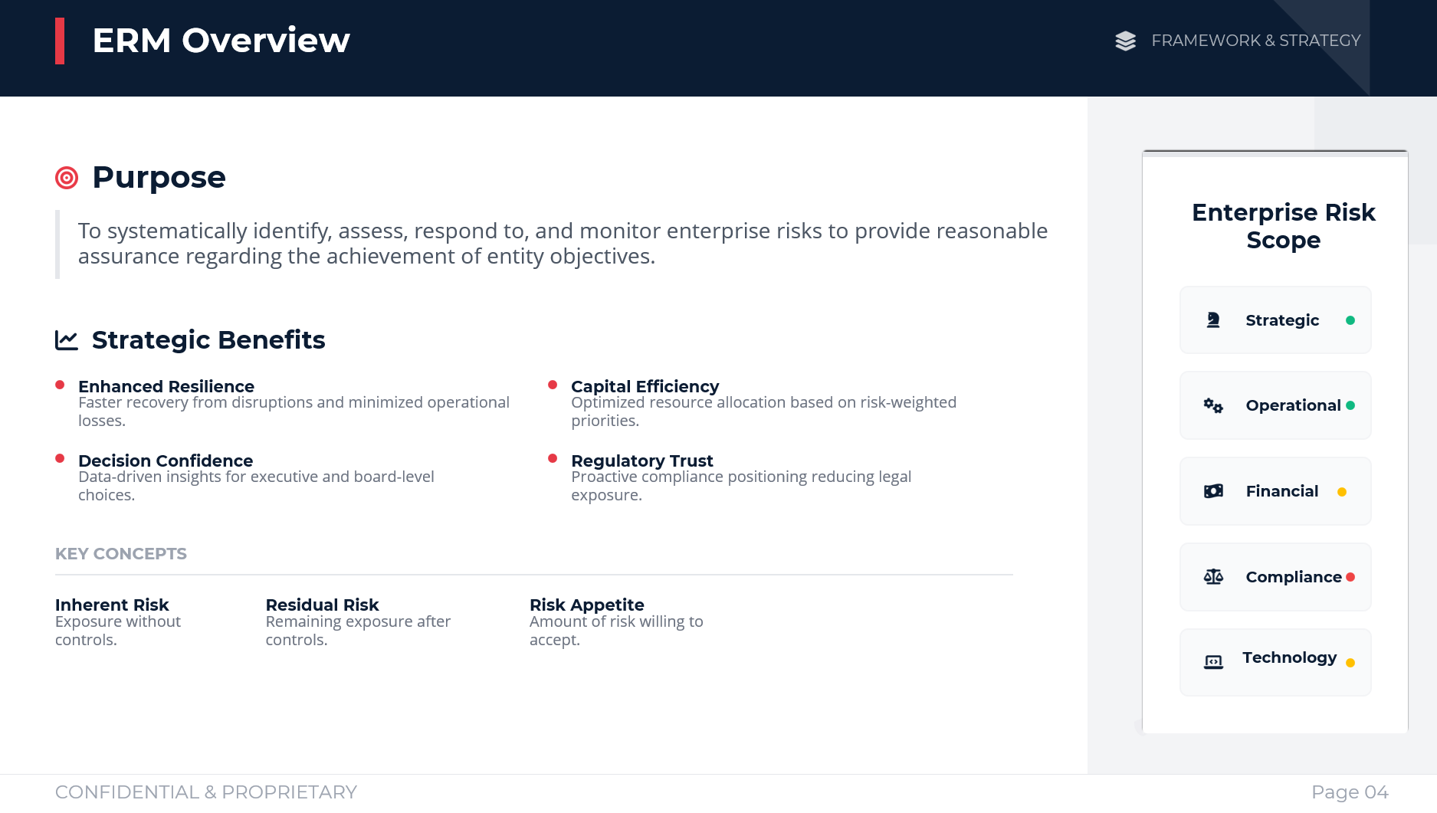
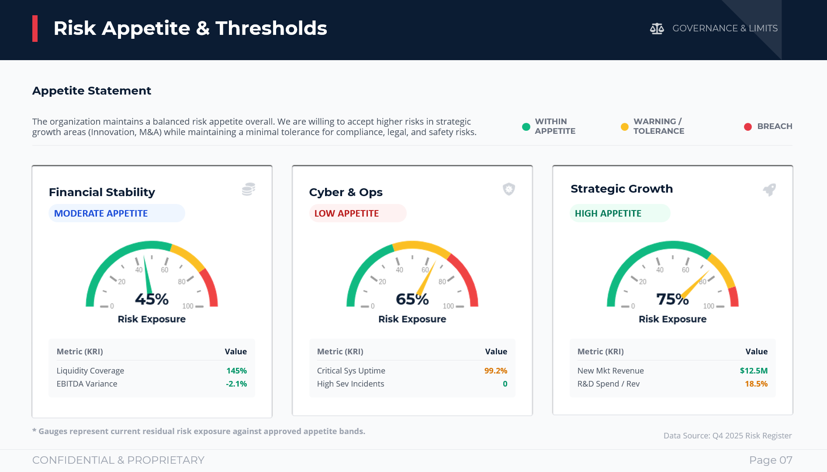
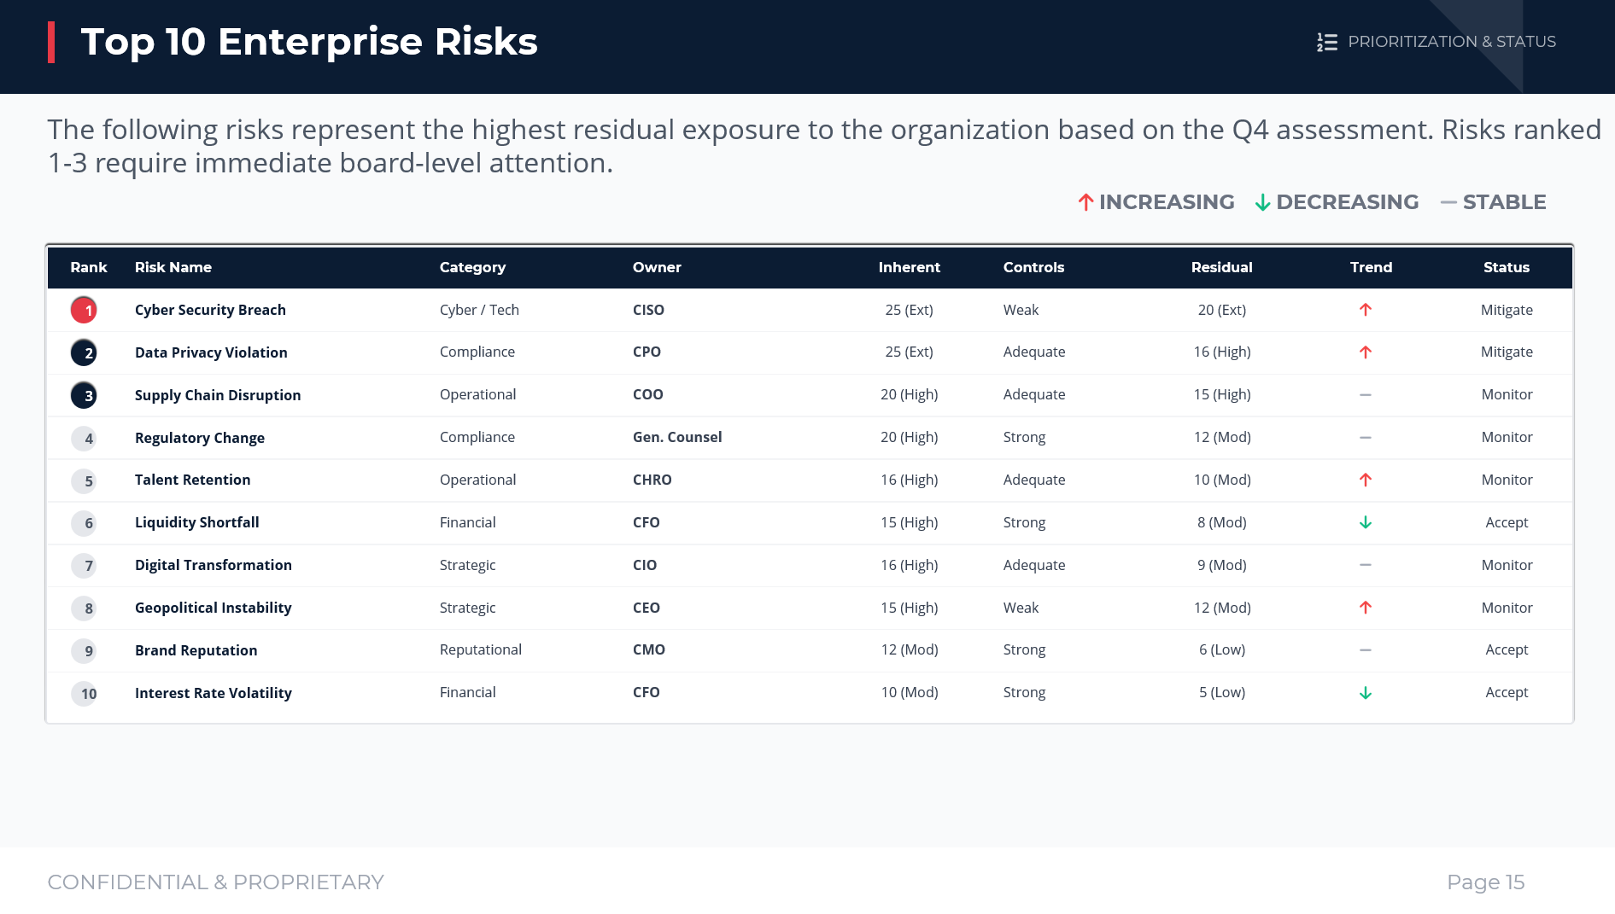
More…
Even more for you. 30 more on business risk management are available for purchase.

Slide 7











PREMIUM PRODUCT
VERSION 2.0 - ENTERPRISE EDITION
Enterprise Risk Management Framework
Professional PowerPoint Template & Dashboard Kit
41 Premium Slides
Customization Level 100% Editable
16:9 HD
Fully Editable
FEATURE CATEGORIES
WHAT'S INCLUDED
Risk Categories Covered 6 Types
1. Foundations
2. Quantitative Analysis
Core frameworks establishing the risk ecosystem.
Advanced modeling and stress testing.
Dashboards & Charts 15+ Visuals
Governance
Risk Appetite
RSCA
Scenarios
Stress Testing
Monte Carlo
Framework Alignment COSO / ISO
3. Operational Excellence
4. Strategic Intelligence
Day-to-day risk monitoring and resilience.
Forward-looking risk positioning.
WHY THIS TEMPLATE?
KRI Library
TPRM
BCP / Crisis
Regulatory Map
Benchmarking
Consulting Grade Quality
Designed with the rigor of top-tier firms (MBB).
Maturity Model
Comprehensive Coverage
From strategy to granular operational controls.
5. Technology & Data
6. Executive Reporting
Systems enabling risk insights.
Communication tools for leadership.
Actionable Visuals
Data-driven layouts ready for your metrics.
Architecture
Data Governance
GRC Stack
Board Pack
Dashboard 1-Pager
Escalation
START CUSTOMIZING
CONFIDENTIAL & PROPRIETARY
Enterprise Risk Management Kit

Slide 8
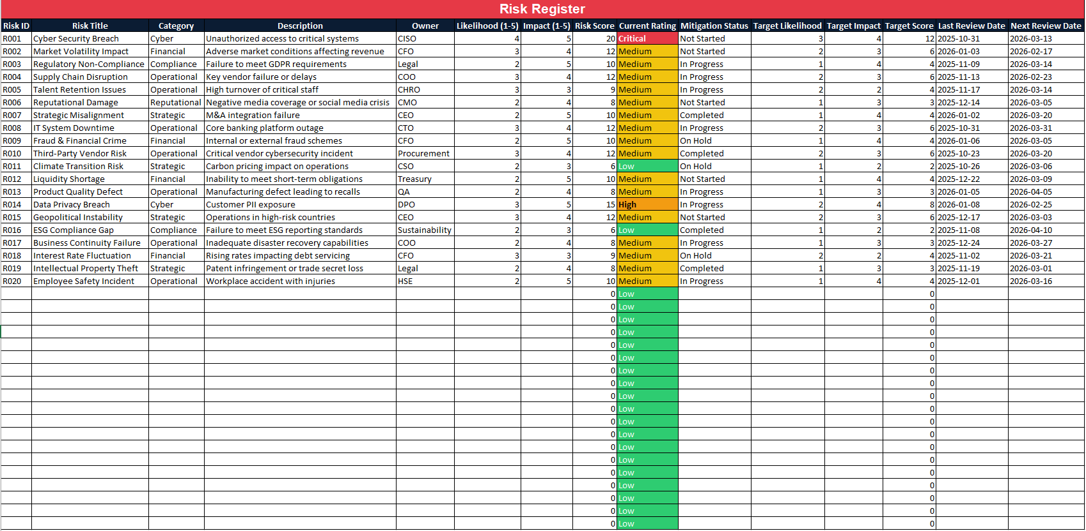
ERM TEMPLATE EXCEL COMPANION - USER GUIDE
Excel file
Enterprise Risk Management (ERM) Toolkit
Full suite available: https://synergieconsultation.podia.com/suite-entreprise-risk-management-erm
WHAT'S INCLUDED
This comprehensive four-file bundle contains everything required for a professional enterprise risk management deployment:
-37 Professional PowerPoint Slides
-Excel Companion Workbook (6 Worksheets)
-12-Month Implementation Project Plan (Excel)
-Implementation Checklist and Best Practices Guide (Word) – 20-page playbook

Slide 9
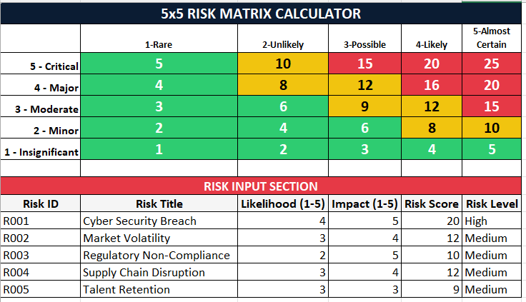
ERM TEMPLATE EXCEL COMPANION - USER GUIDE
Excel file
Enterprise Risk Management (ERM) Toolkit
Full suite available: https://synergieconsultation.podia.com/suite-entreprise-risk-management-erm
WHAT'S INCLUDED
This comprehensive four-file bundle contains everything required for a professional enterprise risk management deployment:
-37 Professional PowerPoint Slides
-Excel Companion Workbook (6 Worksheets)
-12-Month Implementation Project Plan (Excel)
-Implementation Checklist and Best Practices Guide (Word) – 20-page playbook

Slide 10
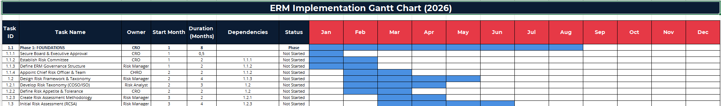
ERM Implementation Project Plan
Excel file
Enterprise Risk Management (ERM) Toolkit
Full suite available: https://synergieconsultation.podia.com/suite-entreprise-risk-management-erm
WHAT'S INCLUDED
This comprehensive four-file bundle contains everything required for a professional enterprise risk management deployment:
-37 Professional PowerPoint Slides
-Excel Companion Workbook (6 Worksheets)
-12-Month Implementation Project Plan (Excel)
-Implementation Checklist and Best Practices Guide (Word) – 20-page playbook

Slide 11
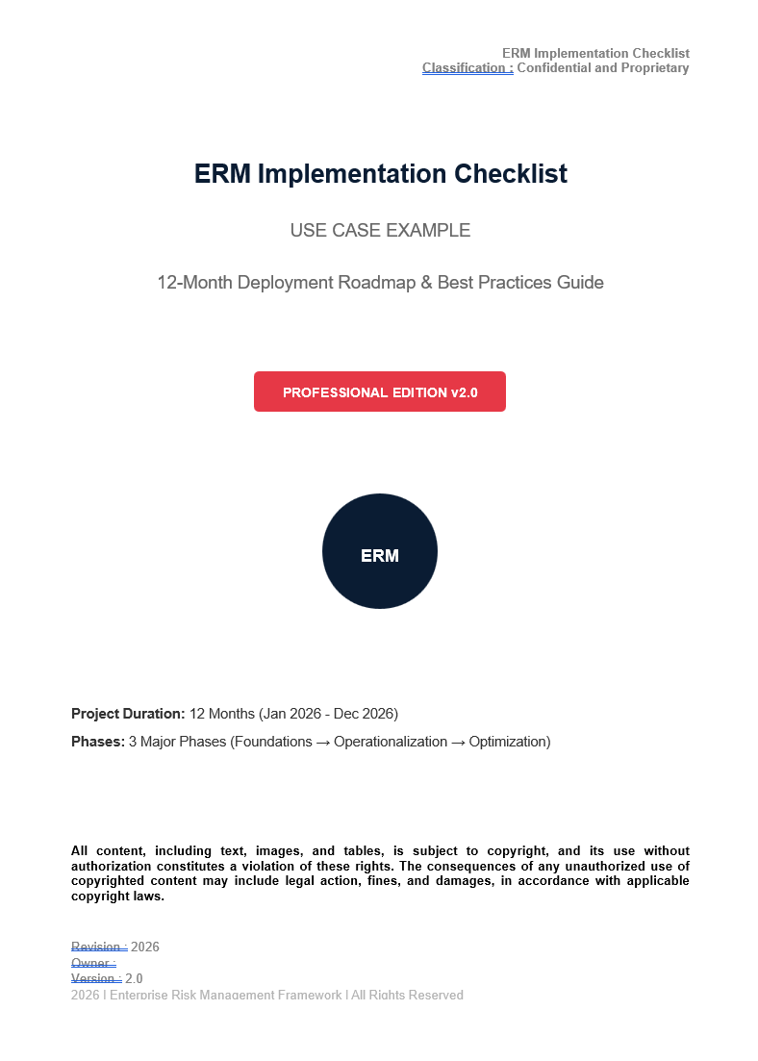
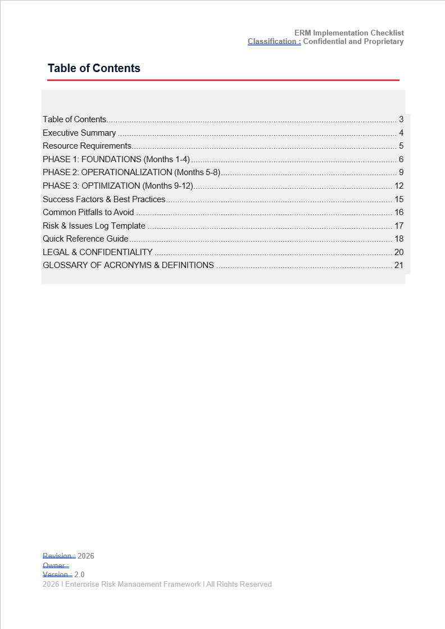
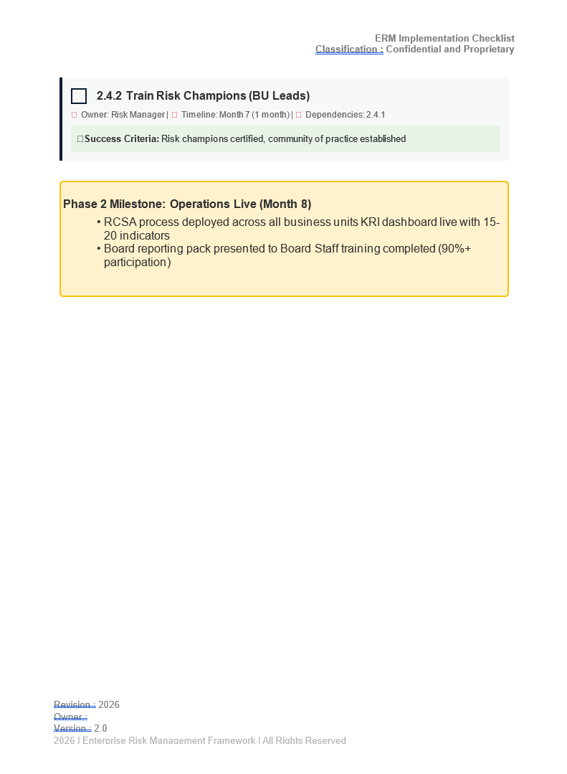
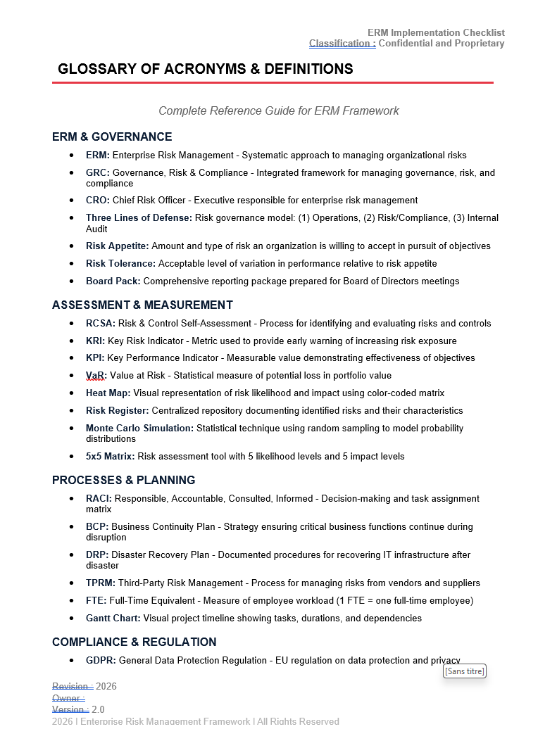
ERM Implementation Checklist
Word file
Enterprise Risk Management (ERM) Toolkit
Full suite available: https://synergieconsultation.podia.com/suite-entreprise-risk-management-erm
WHAT'S INCLUDED
This comprehensive four-file bundle contains everything required for a professional enterprise risk management deployment:
-37 Professional PowerPoint Slides
-Excel Companion Workbook (6 Worksheets)
-12-Month Implementation Project Plan (Excel)
-Implementation Checklist and Best Practices Guide (Word) – 20-page playbook

