Slide 1

GLOBAL ENTERPRISE SECURITY
DECEMBER 2025
CISO BOARD REPORT & STRATEGY 2025
Our mission is to protect enterprise value by reducing cyber risk, ensuring operational resilience, and enabling secure business growth.
CONFIDENTIAL — BOARD USE ONLY
Office of the Chief Information Security Officer
Security Strategy & Governance

Slide 2

CISO BOARD REPORT
December 2025
Agenda
This strategic overview outlines our comprehensive approach to cybersecurity governance, operational resilience, and future-proofing the enterprise against emerging threats in 2025.
STRATEGIC FRAMEWORK
THREAT LANDSCAPE
RISK ASSESSMENT
OBJECTIVES
OPERATIONAL EXCELLENCE
METRICS
COMPLIANCE
GOVERNANCE
TECHNOLOGY
IMPLEMENTATION
BUDGET
TEAM

Slide 3







CISO BOARD REPORT & STRATEGY
December 2025
THREAT LANDSCAPE
A strategic shift from opportunistic exploitation to sophisticated, AI-enhanced targeting of critical infrastructure and supply chains requires a pivot in defensive posture.
OPERATIONAL REALITY
2024
EMERGING VECTORS
2025
Ransomware-as-a-Service
AI-Driven Attacks
High-volume double extortion attacks targeting unpatched vulnerabilities and backups.
Deepfake impersonation of executives and polymorphic malware that evades static detection.
Legacy Exploitation
Supply Chain Depth
Automated scanning and exploitation of known CVEs in VPNs and edge devices.
Compromise of 3rd and 4th party software dependencies to bypass perimeter controls.
Credential Harvesting
Cloud Identity Targeting
Broad-spectrum phishing campaigns aimed at harvesting diverse employee credentials.
Nation-state actors targeting specific cloud IAM roles and non-human identities.

Slide 4



CISO BOARD REPORT
DECEMBER 2025
KEY STRENGTHS
24/7 SOC Operations: Fully matured incident detection and response capabilities.
95% EDR Coverage: High visibility across all corporate endpoints.
MATURITY LEVEL: 3.8 / 5.0
100% MFA Enforcement: Deployed across entire workforce and critical apps.
SECURITY
Resilience Testing: Regular quarterly tabletop exercises conducted.
POSTURE
CRITICAL GAPS
Legacy OT Segments: Lack of segmentation in manufacturing zones.
Current assessment indicates a robust defensive foundation with high visibility across endpoints and strong identity controls. However, critical modernization gaps in OT environments and third-party risk visibility require immediate strategic investment.
Third-Party Visibility: Limited real-time monitoring of vendor risk.
CSPM Drift: Configuration management gaps in multi-cloud environments.
Identity Lifecycle: Manual processes for contractor access management.

Slide 5






CISO BOARD REPORT
December 2025
THIRD-PARTY
RISK MGMT
Onboarding Due Diligence
Risk-tiered assessment framework mandating rigorous security checks before contract signing based on data access levels.
Evidence-Based Assessment
Transitioned from self-attestation questionnaires to validating controls via SOC 2 Type and ISO 27001 audit reports.
Continuous Monitoring
Real-time telemetry and external attack surface monitoring to detect vendor security posture drift post-onboarding.
Contractual Enforcement
Standardized security riders including 24-hour breach notification SLAs and right-to-audit clauses for all high-risk vendors.
Offboarding Controls
Automated access revocation workflows and mandatory data destruction certification upon contract termination.

Slide 6

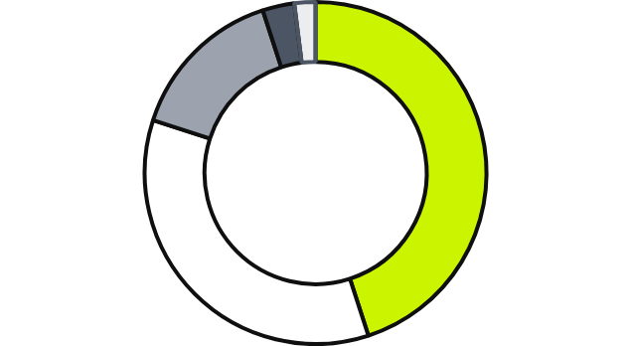

CISO BOARD REPORT & STRATEGY
December 2025
BUDGET
ALLOCATION
Optimizing spend for maximum risk reduction. The 2025 budget prioritizes automation and talent retention while shifting towards OpEx to support scalable cloud defense.
INVESTMENT
Mix
TOTAL APPROVED BUDGET (2025)
$2.5 Million
OpEx: 65%
CapEx: 35%
Technology
45%
People
35%
Software, Infrastructure, Tools
Salaries, Benefits, Recruiting
Note: Technology allocation includes new ZTA infrastructure and SIEM licensing renewals.
Services
15%
Training
3%
Contingency
2%
MDR, Pentesting, Consulting

Slide 7




CISO BOARD REPORT
December 2025
Next Steps
& Approval
REQUEST: Approve 2025 Budget &
Risk Strategy
Q1
Q2
Q4
Roadmap Checkpoint
Midyear Risk Update
Annual Strategy Review
ALEXANDER CHEN, CISO
ciso.office@enterprise.com
+1 (555) 019-2025
Global Enterprise Security

